Slide 1
Making Recommendations

Slide 2
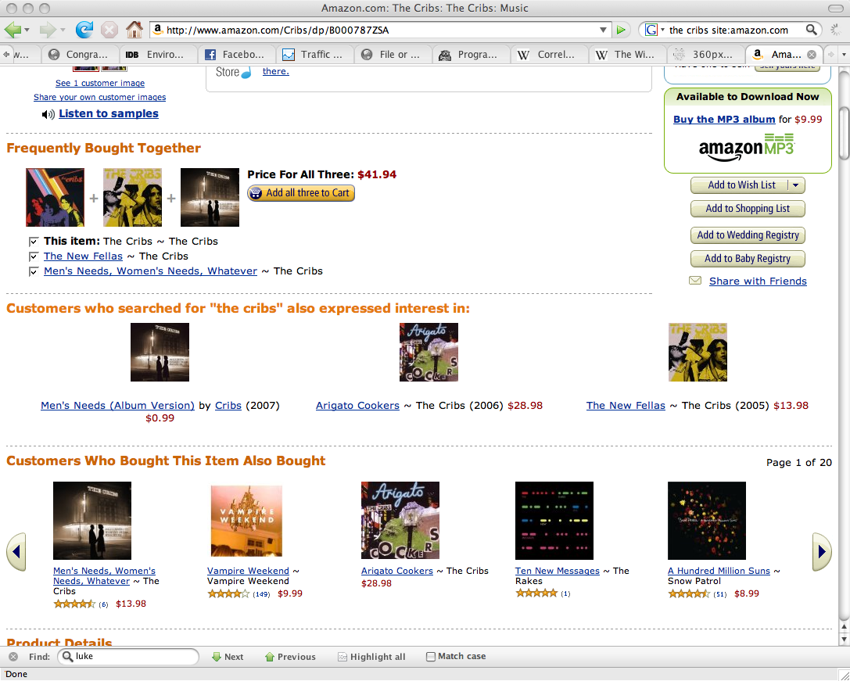
Recommendations

Slide 3
Collaborative Filtering
Observe historical data, find identities with similar preferences
David Goldberg: Using collaborative filtering to weave an information tapestry, 1992.
  http://www.ischool.utexas.edu/~i385d/readings/Goldberg_UsingCollaborative_92.pdf
  Tapestry system

Slide 4
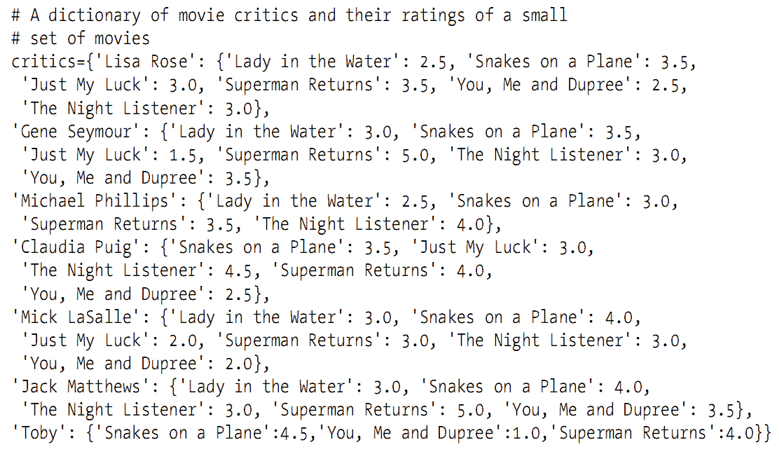
Collecting Preferences
Suppose you have the dictionary below:

Slide 5
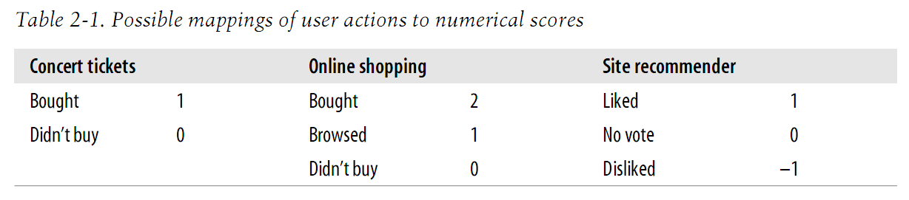
Collecting Preferences
Possible rating types

Slide 6
Finding Similar Users
Determine how similar people are in their tastes
  Define taste
Similar, how?
  Eucledian distance
  Pearson correlation
  What else?

Slide 7
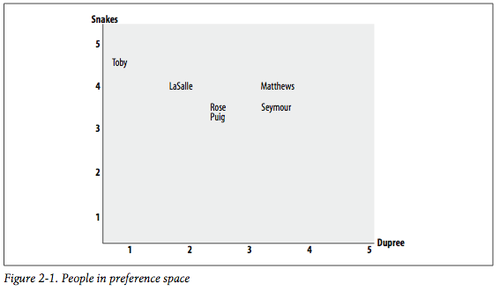
Comparing Reviews of 2 Movies

Slide 8
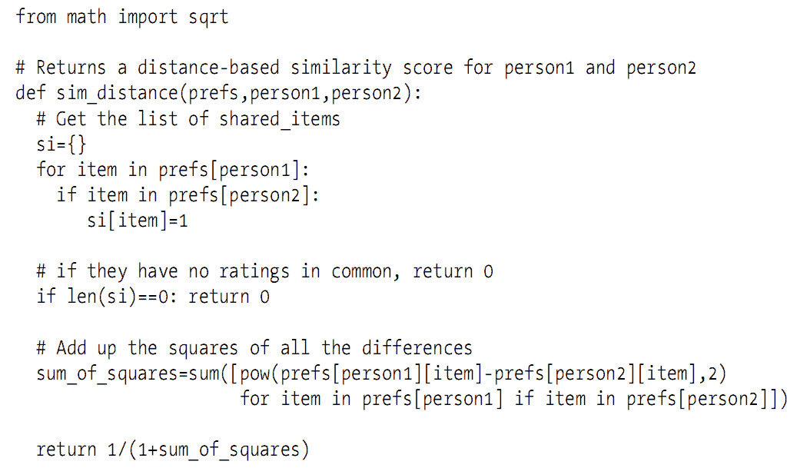
Eucledian Distance

Slide 9
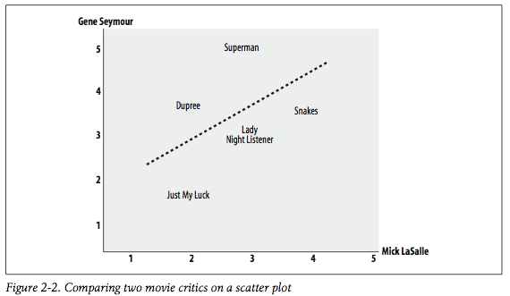
Comparing 2 Reviewers

Slide 10
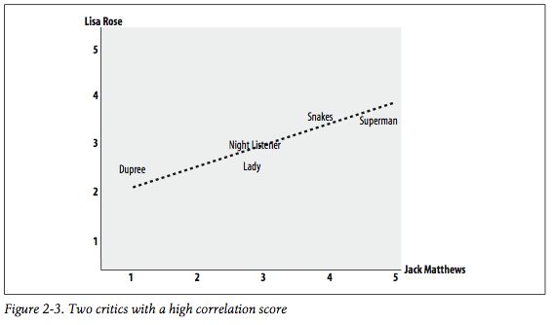
2 Highly Correlated Reviewers

Slide 11
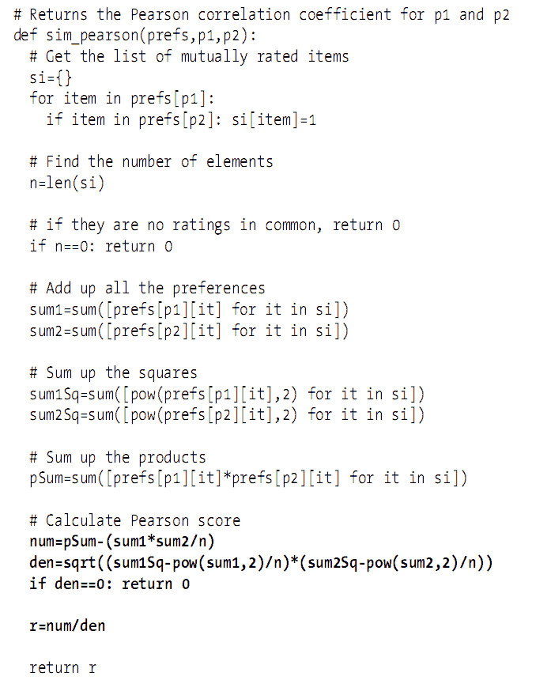
Pearson Correlation

Slide 12
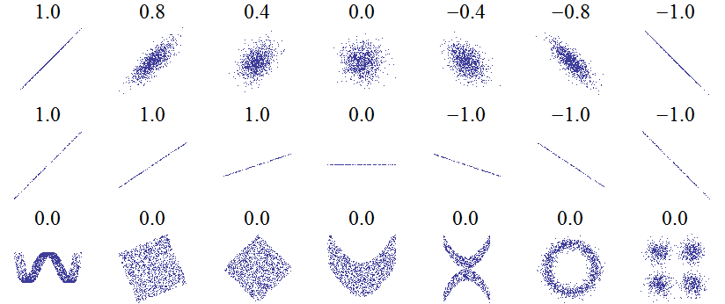
Correlation
A measure of a linear relationship between two independent variables
from: http://en.wikipedia.org/wiki/Correlation

Slide 13
Correlation
In the book, we use “Pearson’s Product Moment Correlation Coefficient”
  http://en.wikipedia.org/wiki/Pearson_product-moment_correlation_coefficient
Many, many, many other coefficients possible
  e.g, for rank data, we often use:
    Spearman’s Rho
    Kendall’s Tau
    http://en.wikipedia.org/wiki/Rank_correlation

Slide 14
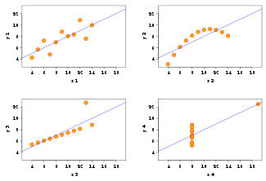
Look at data first!!!
Pearson’s only works for linear (i.e., normal distributions)
  non parametric correlation methods needed for non-normal distributions
    http://en.wikipedia.org/wiki/Correlation#Non-parametric_correlation_coefficients
Example: Anscombe’s Quartet
  http://en.wikipedia.org/wiki/Anscombe%27s_quartet

Slide 15
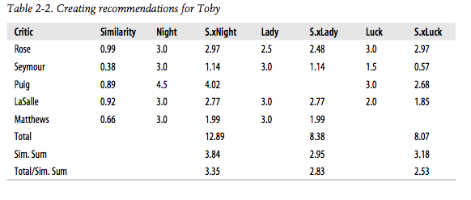
Recommendations Based on Past Rankings
Note not all reviewers have seen all movies!

Slide 16
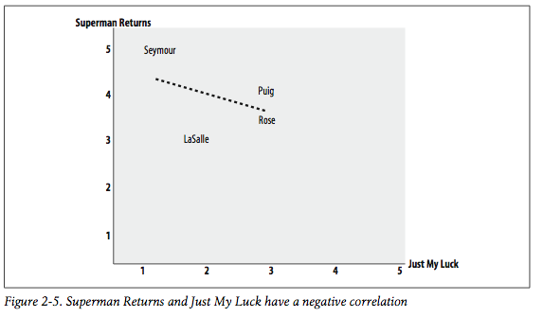
“If you like X, you probably won’t like Y.”

Slide 17
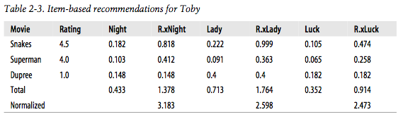
Item Based Recommendations
(i.e., movies instead of critics)

Slide 18
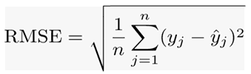
Using MovieLens Dataset
Homework
  http://www.grouplens.org/node/12
  Pick 10% as test, 90% as training (historical data), 10 times random experiments
  Performance benchmark: RMSE

